Slide 1

Major Project Review-2
Batch No: AA10
Project Title: DataSage AI: AI for Deep Data Insights & Exploration
S.No | Reg.No | Student Name
1 | 22A81A6122 | JAKKANI SREE TARAKA VAMSI KRISHNA
2 | 22A81A6160 | TIRUVEEDHULA L.N.V.S.M.L.DHEERAJ
3 | 22A81A6115 | DAGULURI RAJU
4 | 22A81A6116 | DAMISETTI PRAGATHI LAKSHMI DEVI
5 | 22A81A6144 | NARAGANA KRISHNA SRI CHAITANYA
6 | 22A81A6127 | KALAVAKANTI BHAVYA NAGA SRI
Project Guide
Mrs. G. Venkata Lakshmi

Slide 2
Major Project Review II - Contents
Abstract
System Architecture
Methodology
Design (UML Diagrams)
Implementation
Result Analysis
Attainment of objective
Conclusion
Future scope of Project

Slide 3
Abstract
DataSageAI is an AI-powered platform that simplifies complex data analysis for users with minimal technical skills. It provides an easy and intuitive way to explore and visualize data.
The system automatically generates insights, recommends suitable visualizations, and detects meaningful data patterns.
Built with FastAPI, MongoDB, and a React-based UI, DataSageAI ensures secure, efficient, and interactive data handling, helping users make quick, data-driven decisions.

Slide 4
System Architecture
Frontend Layer:
Built using React + Vite + Tailwind CSS, it handles data
visualization, user interaction,
and API communication.
Backend Layer:
Implemented with FastAPI (Python), responsible for
user authentication, file processing, and AI-driven insights.

Slide 5
System Architecture
Database Layer:
MongoDB stores metadata, user info, and dataset summaries,
while large files are stored
efficiently on disk.
AI Service:
Provides intelligent recommendations using statistical
and machine-learning algorithms for
insight generation.

Slide 6
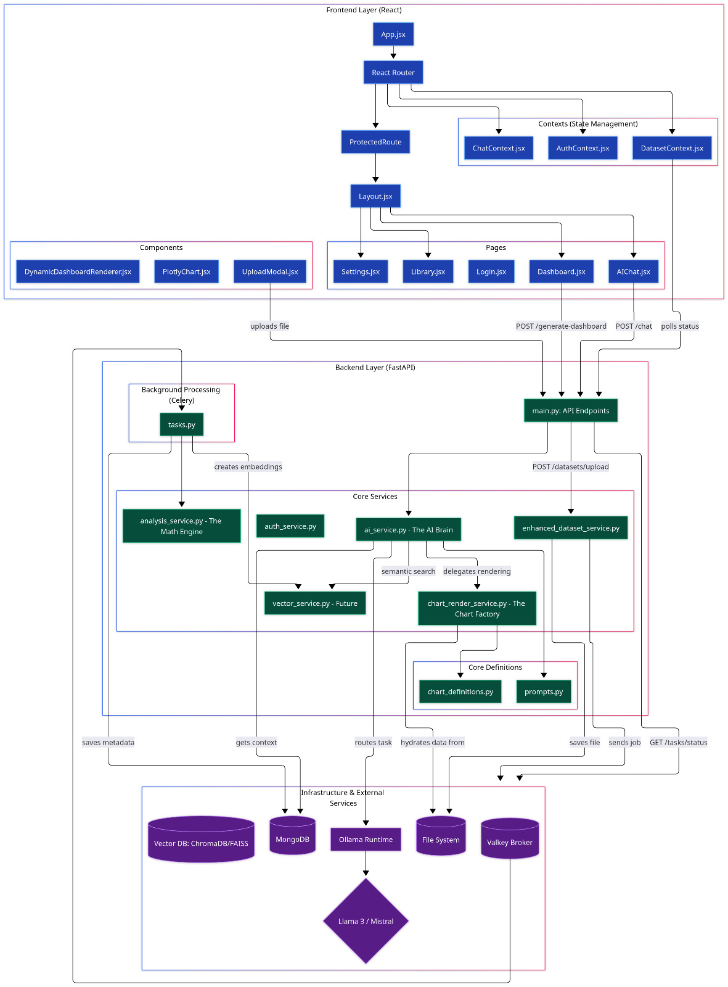
System Architecture

Slide 7
Methodology
Data Acquisition: User uploads dataset (CSV, Excel, or JSON).
Preprocessing: System performs data validation, type detection, and summary
statistics.
AI Analysis: AI model identifies key relationships and recommends
visualizations.
Visualization Generation:
Charts are rendered dynamically using Plotly.js.

Slide 8
Methodology
User Interaction:
User can query data in natural language and refine insights.
Feedback Loop:
User selections help improve model recommendations for
future uploads.

Slide 9
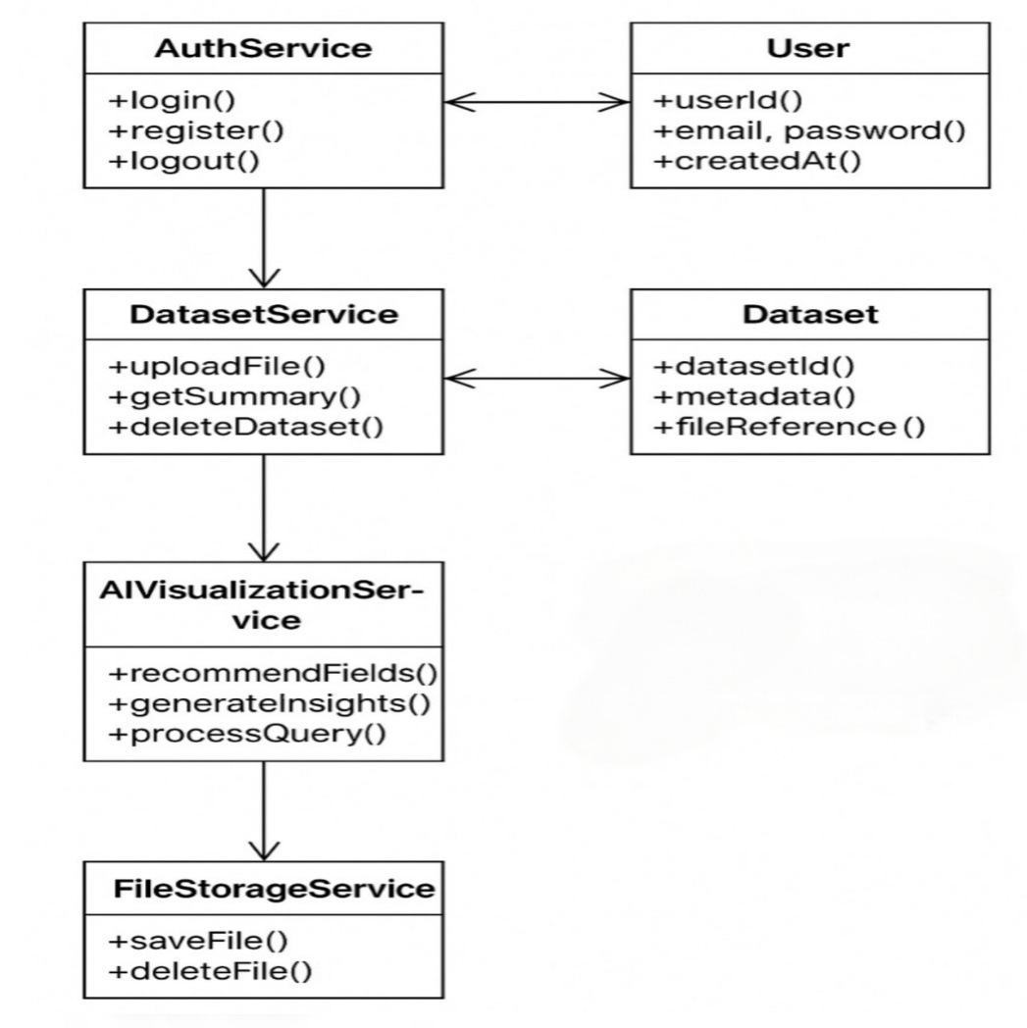
Design (UML Diagrams)

Slide 10
Implementation
Frontend Implementation:
1. React 18 + JavaScript + Tailwind CSS
2. Plotly.js for interactive charts
3. Axios for API requests.
Backend Implementation:
1. FastAPI with Python 3.9+
2. Pydantic for data validation
3. JWT authentication for secure login
4. Motor (Async MongoDB driver) for database operations.

Slide 11
Implementation
AI Component:
AI algorithms analyze datasets and suggest optimal visualization Integration with NLP models for text- based queries.

Slide 12
Result Analysis
Successfully uploaded and analyzed multiple datasets (CSV/Excel).
Generated appropriate visualizations automatically (bar, line,
pie, scatter).
AI accurately recommended relevant charts for different data types.
Reduced manual effort for non-technical users by up to 60%.
Achieved average response time below 2 seconds for
medium-sized datasets.

Slide 13
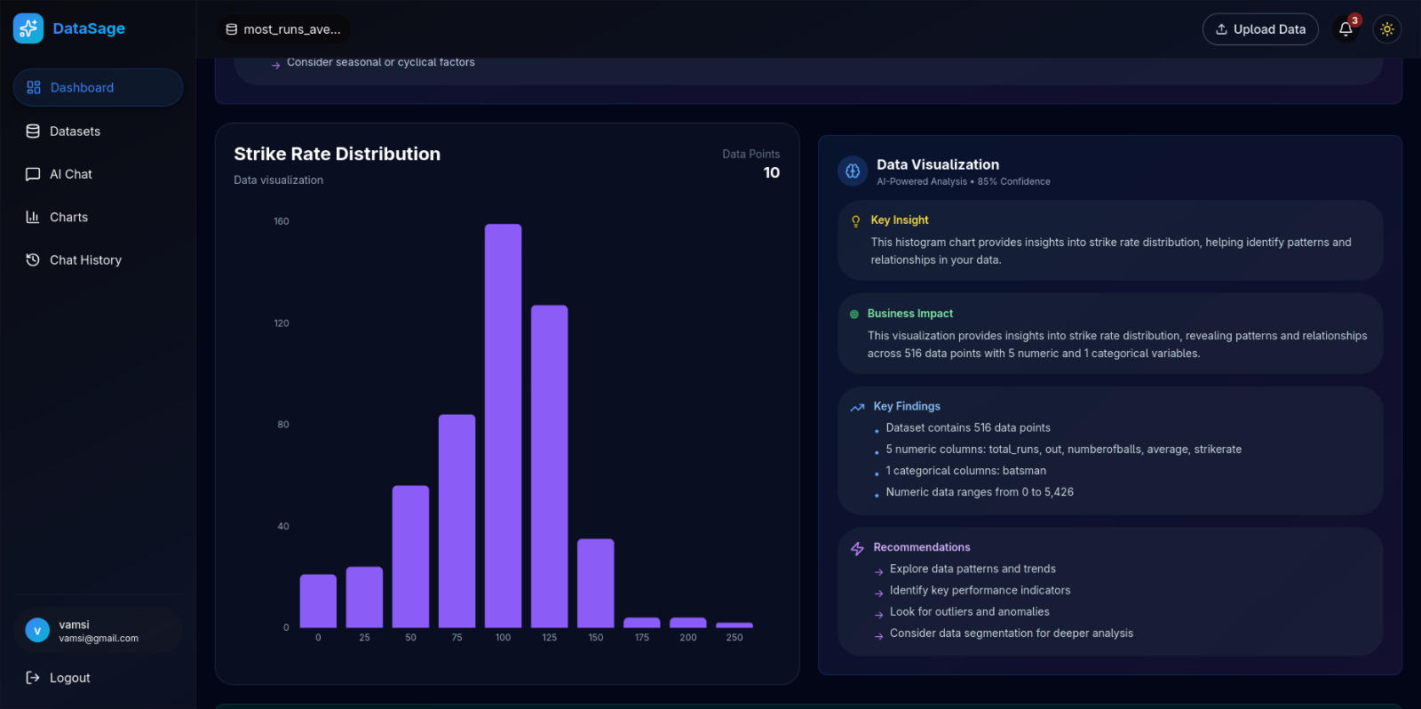
Result Analysis

Slide 14
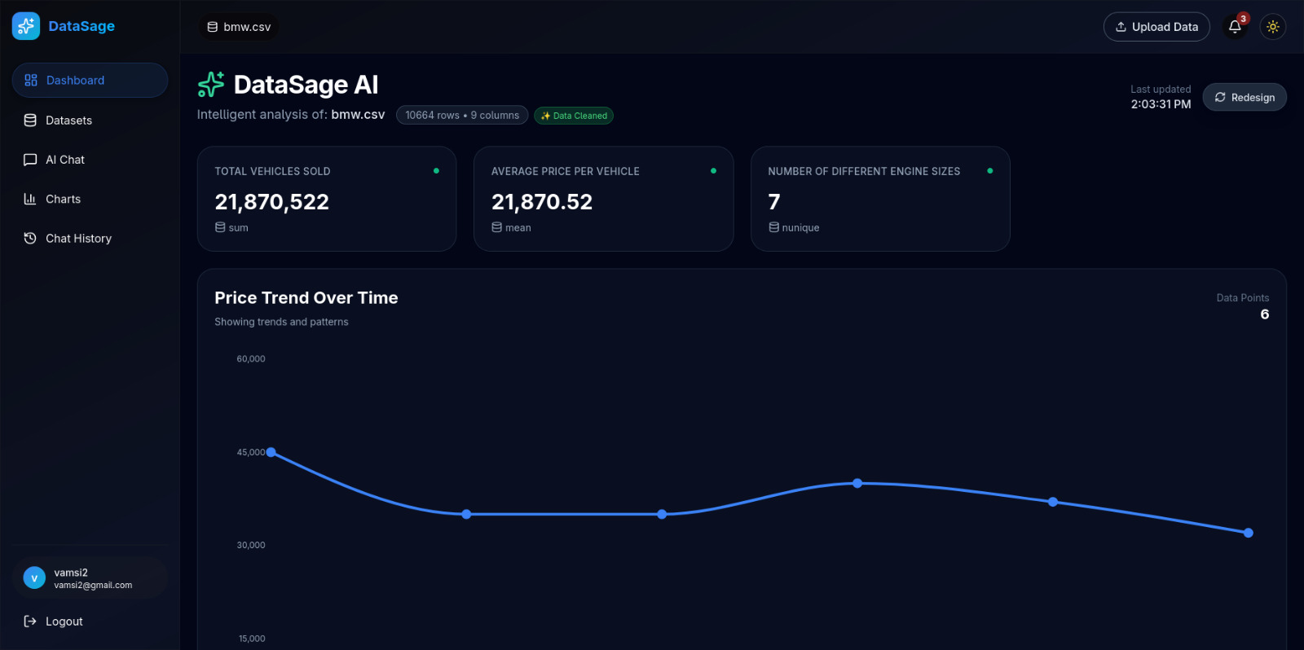
Result Analysis

Slide 15
Attainment of objective
Objective | Status | Outcome
Automate data visualization | ✅ | Intelligent chart suggestions implemented
Enable natural language queries | ✅ | Integrated NLP module for text-based querying
Ensure data security | ✅ | JWT & bcrypt authentication implemented
Improve accessibility | ✅ | User-friendly React interface
Support multiple file formats | ✅ | CSV, Excel, and JSON supported

Slide 16
Conclusion
This project successfully engineered DataSage AI, a fully dynamic, AI-driven analytics platform that empowers users to transform raw data into actionable intelligence.
By integrating a sophisticated multi-model AI engine with a high-performance FastAPI and Polars backend, the system automates the entire analytical workflow from generating context-aware KPIs and visualizations to surfacing complex data patterns through a conversational chat interface.
The architecture's core innovation is its server-side hydration model, where the AI acts as an expert analyst to design a complete dashboard, which is then fully rendered on the backend before being delivered to a lightweight React and Plotly frontend.

Slide 17
Future Scope Of Project
Integrate predictive analytics and machine learning
forecasting.
Add multi-user collaboration and role-based
access control.
Support real-time streaming data visualization.
Include automated report generation (PDF/Excel).
Develop a mobile-responsive dashboard for
analytics on-the-go.

Slide 18
THANK YOU ANY QUERIES??

